Slide 1
From Research Foundations to Quality Publications
Introduction to Research
Mirza Niaz Morshed

Slide 2
Topics
Scope of research
Types of research
Key areas in research
Ethical considerations in research
Research Metrics and Citations

Slide 3
Scope of Research
Research is a systematic and methodical investigation aimed at discovering, interpreting, and advancing knowledge. The scope of research defines its boundaries, applicability, and significance across various fields.

Slide 4
Why is Research Important?
Advances scientific and technological knowledge.
Solves real-world problems in industries, healthcare, and society.
Supports policy-making and business strategies.
Encourages innovation and interdisciplinary collaboration.

Slide 5
Find a Research Scope: Step-by-Step
Step 1: Identify Your Research Interests
Reflect on your passion/expertise: What topics excite you?
Review past coursework/projects: Which areas did you perform well in?
Follow industry trends: What are emerging fields (e.g., AI, sustainability, blockchain)?
Example: If you studied computer science, you might explore AI ethics or quantum computing.

Slide 6
Find a Research Scope: Step-by-Step
Step 2: Conduct a Preliminary Literature Review
Search academic databases (Google Scholar, IEEE Xplore, Scopus).
Identify gaps: Look for unanswered questions or conflicting findings.
Note key papers/authors: Who are the leading researchers in your field?
Tools:
  Keyword search (e.g., "machine learning in healthcare").
  Citation tracking (see who cited a major paper).

Slide 7
Find a Research Scope: Step-by-Step
Step 3: Define the Problem Statement
Narrow down focus: Avoid overly broad topics.
Use the FINER criteria:
  Feasible (Do you have resources?)
  Interesting (Is it engaging?)
  Novel (Is it original?)
  Ethical (Does it follow research ethics?)
  Relevant (Does it matter to society/industry?)
Example:
❌ Too broad: "AI in healthcare"
✅ Better: "Explainable AI for early detection of diabetic retinopathy"

Slide 8
Find a Research Scope: Step-by-Step
Step 4: Consult with Advisors/Experts
Discuss feasibility with professors or industry professionals.
Get feedback on novelty and methodology.
Refine scope based on expert input.
Questions to ask:
  "Has this been done before?"
  "What are the practical challenges?"

Slide 9
Find a Research Scope: Step-by-Step
Step 5: Assess Available Resources
Time: Can you complete it within deadlines?
Funding: Do you need grants/lab access?
Data: Is there available/open-source data?
Tools: Do you need specialized software/hardware?
Example: If researching deep learning, check GPU availability for training models.

Slide 10
Find a Research Scope: Step-by-Step
Step 6: Consider Societal & Industry Impact
Why does this research matter?
  Does it solve a real-world problem?
  Will it influence policies or business strategies?
Example:
  "Blockchain for secure medical records" → Impacts healthcare data privacy.

Slide 11
Find a Research Scope: Step-by-Step
Step 7: Validate Scope with a Research Proposal
Write a brief proposal (~1-2 pages) covering:
  Background (Why this topic?)
  Objectives (What will you achieve?)
  Methodology (How will you conduct research?)
  Expected outcomes (What impact will it have?)
Peer Review: Share with colleagues for feedback.

Slide 12
Find a Research Scope: Step-by-Step
Step 8: Refine & Finalize Scope
Eliminate ambiguities: Ensure clarity in research questions.
Set boundaries: Define what is included/excluded.
Stay flexible: Be open to adjustments as research progresses.
Example:
  "This study focuses on supervised learning models, excluding unsupervised methods."

Slide 13
Find a Research Scope: Step-by-Step
Common Mistakes to Avoid
  ❌ Too broad: "Cybersecurity threats" → Better: "Ransomware detection using ML."
  ❌ Too narrow: "Impact of Python version 3.11 on a specific library" → May lack significance.
  ❌ Ignoring feasibility: Proposing quantum computing research without lab access.

Slide 14
Key Dimensions of Research Scope
A. Academic & Theoretical Research
Purpose: Expands fundamental knowledge in sciences, humanities, and engineering.
Examples:
  Developing new mathematical models.
  Exploring philosophical theories.
  Studying behavioral patterns in psychology.

Slide 15
Key Dimensions of Research Scope
B. Applied & Industrial Research
Purpose: Solves practical problems and improves technologies.
Examples:
  AI-driven healthcare diagnostics.
  Renewable energy solutions for sustainability.
  Cybersecurity advancements for data protection.

Slide 16
Key Dimensions of Research Scope
C. Interdisciplinary Research
Purpose: Combines multiple fields for innovative solutions.
Examples:
  AI + Medicine (Predictive healthcare analytics).
  Blockchain + Finance (Decentralized finance).
  IoT + Agriculture (Smart farming).

Slide 17
Types of Research
A. Original Research
Definition: Generates new knowledge through experiments, surveys, or simulations.
Characteristics:
  Tests hypotheses.
  Involves data collection.
Examples:
  Inventing a new machine learning model.
  Discovering a chemical compound.

Slide 18
Types of Research
B. Review Research
Definition: Summarizes and evaluates existing research.
Types:
  Narrative Review: Broad overview of a topic.
  Systematic Review: Structured analysis of multiple studies (common in medicine).
  Meta-Analysis: Statistically combines results from different studies.
Example:
  A paper summarizing 50 studies on blockchain security risks.

Slide 19
Types of Research
C. Descriptive Research
Goal: Observe and document phenomena without manipulation.
Methods:
  Case studies, observational studies.
Example:
  A report on consumer behavior in e-commerce.

Slide 20
Types of Research
D. Experimental Research
Goal: Establish cause-effect relationships.
Methods:
  Controlled lab experiments, A/B testing.
Example:
  Testing two website designs to see which gets more clicks.

Slide 21
Types of Research
E. Exploratory Research
Goal: Investigate an unclear problem.
Methods:
  Pilot studies, open-ended surveys.
Example:
  Studying how Gen Z uses AI chatbots (new, underexplored topic).

Slide 22
Types of Research: At a Glance
Research can be categorized by:
✔ Purpose (Basic, Applied, Action).
✔ Methodology (Qualitative, Quantitative, Mixed).
✔ Data Source (Primary, Secondary).
✔ Specialization (Longitudinal, Case Study, etc.).

Slide 23
Key Areas in Research
Computer Science & Information Technology
Cybersecurity
Cryptography, blockchain security
Network security, intrusion detection
Ethical hacking, cyber forensics
Internet of Things (IoT)
Smart cities, industrial IoT
Wearable technology, health monitoring
Sensor networks, edge computing
Artificial Intelligence & Machine Learning
Neural networks, deep learning, reinforcement learning
Natural language processing (NLP), computer vision
Explainable AI, ethical AI, AI safety
Data Science & Big Data
Predictive analytics, data mining
Cloud computing, distributed systems
Business intelligence, data visualization

Slide 24
Key Areas in Research
Engineering & Technology
Civil & Environmental Engineering
Smart infrastructure, earthquake-resistant design
Water resource management
Green construction materials
Electrical & Electronics Engineering
Power systems, renewable energy integration
Semiconductor technology, VLSI design
Robotics, automation systems
Mechanical & Aerospace Engineering
Advanced materials, nanotechnology
Aerodynamics, space exploration tech
Sustainable energy systems

Slide 25
Key Areas in Research
Biomedical & Life Sciences
Medical Research
Precision medicine, genomics
Biomedical imaging, prosthetics
Drug discovery, vaccine development
Biotechnology
CRISPR gene editing
Synthetic biology
Biofuels, agricultural biotech

Slide 26
Key Areas in Research
Business & Economics
Digital Transformation
Fintech, blockchain applications
E-commerce, digital marketing analytics
AI in business decision-making
Behavioural Economics
Consumer psychology
Nudge theory applications
Market trend prediction

Slide 27
Key Areas in Research
Emerging Interdisciplinary Fields
Legal Tech: AI in law, smart contracts
Neurotechnology: Brain-computer interfaces
Quantum Computing: Cryptography, optimization problems
Sustainable Tech: Circular economy, carbon capture

Slide 28
Key Areas in Research
Social Sciences & Humanities
Computational social science
Digital humanities, AI in education
Cybersecurity policy, digital ethics

Slide 29
Choosing Your Research Area
Align with expertise: Match to your academic background
Consider impact: Societal vs commercial applications
Assess resources: Data/tools availability
Future relevance: Growth potential of the field

Slide 30
Ethical considerations in Research
Key Principles
Integrity: Honest reporting of methods and results.
Plagiarism Avoidance: Proper citation of sources.
Confidentiality: Protecting participant data.
Informed Consent: Participants must voluntarily agree.
Conflict of Interest: Disclose funding sources or biases.

Slide 31
Ethical considerations in Research
Ethical Violations & Consequences
Data fabrication → Loss of credibility, retractions.
Unauthorized use of human/animal subjects → Legal penalties.
Institutional Oversight
IRB (Institutional Review Board): Approves human subject research.
Peer Review: Ensures validity before publication.

Slide 32
Journal Metrics & Citations
Understanding Citations
Citations are references to published works that researchers use to:
Give credit to original authors
Support arguments with evidence
Enable readers to locate original sources

Slide 33
Research Metrics & Citations
Types of Citations
In-text citations (e.g., APA, MLA, IEEE)
Bibliography/References (full source details)
Self-citations (referencing one's own work)
Why Citations Matter
Measure research impact
Establish credibility & avoid plagiarism
Help track academic influence

Slide 34
Research Metrics & Citations
In-Text Citations
In-text citations are brief references within the body of your work that point readers to the full source in your bibliography.
Key Characteristics
Appear inside paragraphs or as footnotes
Include minimal information (author, year, page if needed)
Link to full references in the bibliography
Style varies by citation format (APA, MLA, IEEE, etc.)
Example:
"Climate change impacts are worsening (Smith, 2020)."
"Recent studies confirm this trend (Johnson & Lee, 2022, p. 45)."

Slide 35
Research Metrics & Citations
References
Definition: A list of all the sources directly cited in your work (quotes, paraphrases, or specific data).
Purpose: To allow readers to locate the sources you used to support your arguments.
Placement: Appears at the end of the document, usually titled "References" (APA), "Works Cited" (MLA), or "Reference List" (Harvard).
Content: Only includes sources actually mentioned in your text.
Example (APA Style):
Smith, J. (2020). Modern Marketing Strategies. Business Press.

Slide 36
Research Metrics & Citations
Bibliography
Definition: A list of all sources consulted during research, whether or not they were cited in the final work.
Purpose: Shows the breadth of your research and may include background readings or sources for further study.
Placement: Also at the end of the document, under the heading "Bibliography".
Content: Includes everything in the references list plus other relevant sources not cited.
Example:
Doe, A. (2018). Foundations of Management. University Press.

Slide 37
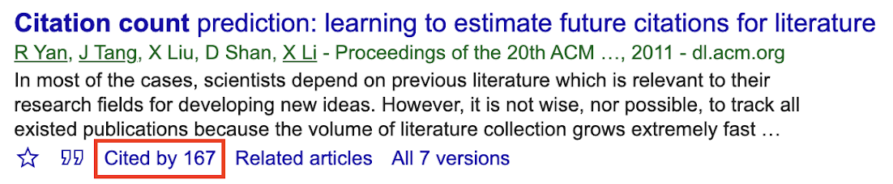
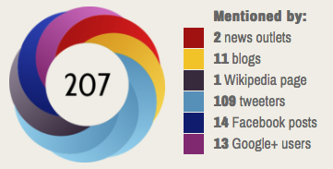
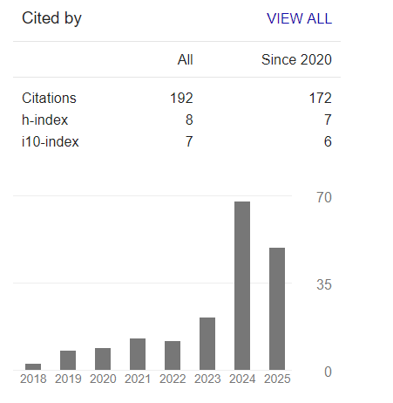
Key Research Metrics
Article-Level Metrics
Metric | Description | Example
Citation Count | Total times a paper is cited | 100 citations
Altmetric Score | Measures online attention (news, social media) | Score of 45
Downloads | Number of times a paper is accessed | 5,000 downloads

Slide 38
Key Research Metrics
Author-Level Metrics
Metric | Description | Formula | Interpretation
h-index (Hirsch index) | Measures productivity & citation impact | h papers cited ≥ h times | h-index 20 = 20 papers with 20+ citations
i10-index | Count of papers with ≥10 citations | – | i10-index 50 = 50 such papers
g-index (generalized index) | Gives more weight to highly cited papers | √(sum of citations) | g-index 30 = 30 most cited papers average 900 citations

Slide 39
Key Research Metrics
Journal-Level Metrics
Metric | Description | Calculation | Example
Impact Factor (IF) | Average citations per article in 2 years | Citations in Year X to articles from X-1 & X-2 ÷ Total citable items | IF 5.0 = 5 citations per article
CiteScore | Scopus' metric (3-year window) | Citations in 3 years ÷ Documents published | CiteScore 7.2
SJR (SCImago Journal Rank) | Weighted citations based on journal prestige | Citations from influential journals count more | SJR 1.5
SNIP (Source Normalized Impact per Paper) | Adjusts for differences in citation behavior across fields | Citations per paper ÷ Citation potential in field | SNIP 2.1

Slide 40
Where to Find These Metrics?
Databases & Tools
Google Scholar (h-index, i10-index, citations)
Scopus (CiteScore, SJR)
Web of Science (Impact Factor, h-index)
Journal Citation Reports (JCR) (Impact Factor rankings)
Alternative Metrics (Altmetrics)
Dimensions (Citations + policy/social impact)
PlumX (Tracks mentions in news, blogs, patents)

Slide 41
How to Improve Research Metrics?
Publish in High-Impact Journals (Check JCR rankings)
Increase Visibility (Share on ResearchGate, LinkedIn)
Collaborate (Co-author with well-cited researchers)
Cite Strategically (Reference recent, relevant works)
Promote Open Access (More accessible = more citations)

Slide 42
Limitations of Research Metrics
Can be skewed by a few highly cited papers; varies by field; does not reflect article quality.
Doesn't account for context (positive vs. negative citations); varies by field and age of the paper.
Disadvantages early-career researchers; insensitive to highly cited outliers.
Measures popularity or attention rather than scholarly impact; vulnerable to hype and manipulation.
Often based on impact factor; may overlook newer or niche journals with strong editorial standards.

Slide 43
Best Practices
✔ Use multiple metrics (not just Impact Factor)
✔ Compare within the same research field
✔ Focus on quality, not just quantity

Slide 44
Thanks to All
Any Question?

